Slide 1
Text Summarization Plugin using LLMs
Group 26
Anurag Choudhary, Hammad Ali, Manu Ravichandrakumar, Sahil Bhende
Notes:
TEMPLATE SLIDE

Slide 2
Introduction
What is this? - A Chrome extension that summarizes the content of any web page using Large Language Models (LLMs).
Why summarization? - Helps users quickly determine whether an article is worth reading.
How it works: - Extracts text → builds prompt → sends to LLM API → displays summary inline.
Who is it for? - Students, researchers, journalists, and casual readers consuming web-based content.
Tech Stack: - JavaScript/TypeScript, Chrome Manifest V3, OpenAI / Gemini APIs, optional TTS and IR modules.
Notes:
Reason for shorter formats of ingestion
How the project idea came into picture
What is this project
Why to summarize, coherence with trend
Users of app and tech stack.

Slide 3
Motivation
Users face content overload and often don’t have time to read full articles.
Web content often includes misleading or clickbait headlines; full articles may not deliver on the promise.
Many articles use rhetorical tricks and vague language to mislead or emotionally influence readers.
Time wasted reading low-quality or irrelevant articles.
Manually opening new tabs to fact-check or get definitions
Our Solution - Give users a fast, reliable, in-page summary + contextual info to make informed reading decisions, without leaving the page.
Inspiration - Mirrors the first pass in the "Three-Pass Approach" to reading academic papers, get the gist before diving deeper.
Notes:
So why build this?
We’re living in a time of information overload—tons of content, limited time. People often click on promising headlines only to find low-quality or misleading content that doesn't deliver.
Many sites use emotional language or rhetorical tricks to keep users engaged, but it wastes time and hurts trust and reliability of a site. This is true whether it be clickbait or actual inadvertent misinformation.
On top of that, manual fact-checking like opening new tabs to understand terms or verify claims is slow and inefficient.
Our solution is to summarize and contextualize content right where you’re reading it. This helps with saving the user’s time because they won’t have to leave the site and can get a summary without much friction.
Think of it as the digital equivalent of the first pass in the academic 'Three-Pass Approach' which means just enough information to quickly decide if deeper reading is worthwhile.

Slide 4
Key Features
One-Click Summarization - Summarizes the main content of textual web page using LLMs
Multi-LLM Support - Easily switch between or add LLM providers via API key settings.
Customizable Output - Users can set a word limit and add custom prompt instructions to tailor tone or focus (e.g., emphasize dates, use bullet points).
Related Articles & Definitions - Retrieves contextually relevant articles and inline definitions for key terms.
Text-to-Speech (TTS) - Reads the summary aloud for improved accessibility and hands-free use.
Non-Intrusive In-Page Overlay - Displays results without opening new tabs or disrupting the reading flow.

Slide 5
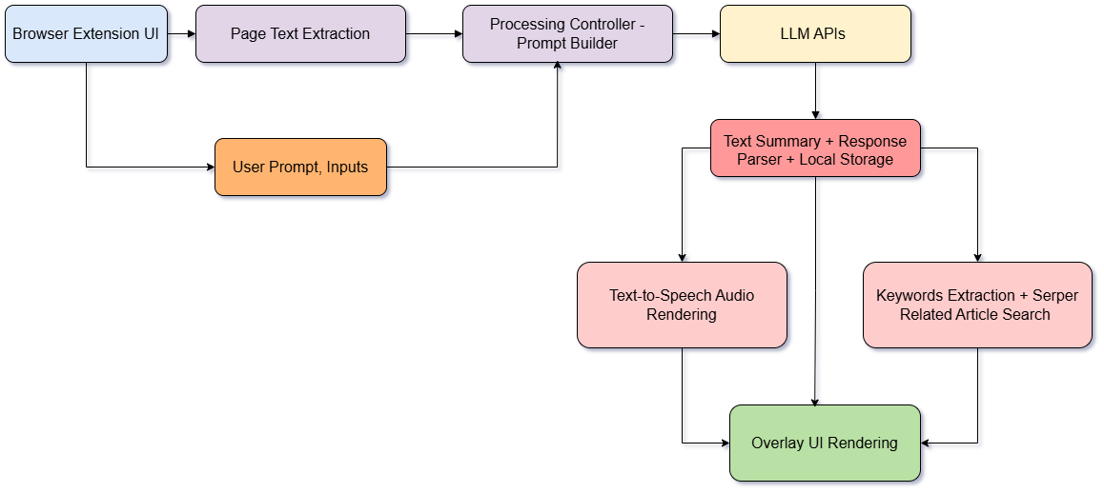
High-Level Architecture

Slide 6
User Workflow Demo
Demo of the browser plugin

Slide 7
Future Work
Multi LLM Summarization
Implement Fang et al. (2025)’s centralized topology
Each model generates its own draft.
a “judge” LLM ranks or merges drafts into a single cohesive summary.
Expand to Other Domains
Target long form, complex texts (e.g. research articles, legal documents)
Individual document chunks to each LLM.
Centralized framework where one LLM synthesizes all the individual summaries.
Multi round refinement to hit quality & consistency targets.
Notes:
Next up, let’s look at some of the areas we could expand this tool in the future.
First, recent work by Fang et al. (2025) shows that an ensemble of LLMs—rather than a single model—produces summaries that align more closely with human judgments, especially for long, information-dense documents.
In our next iteration, we hope to implement their centralized topology where two or more LLMs each draft a summary, then a third LLM acts as a judge to determine the best summary.
Building on top of that, we also would want to expand to other domains, particularly targeting long form, complex documents like scientific research articles and legal documents. Each LLM agent will be responsible for drafting the summaries for individual document chunks, then the centralized judge LLM will be responsible for synthesizing the individual summaries into one cohesive summary. Optionally, we can have multi round refinement to hit quality and consistency targets.

Slide 8
Thank you

